Slide 1
AMSC 663 Mid Year Presentation, Fall 2012
Locating Faulty Rolling Element Bearing Signal by Simulated Annealing
Jing Tian
Course Advisor: Dr. Balan, Dr. Ide
Research Advisor: Dr. Morillo

Slide 2
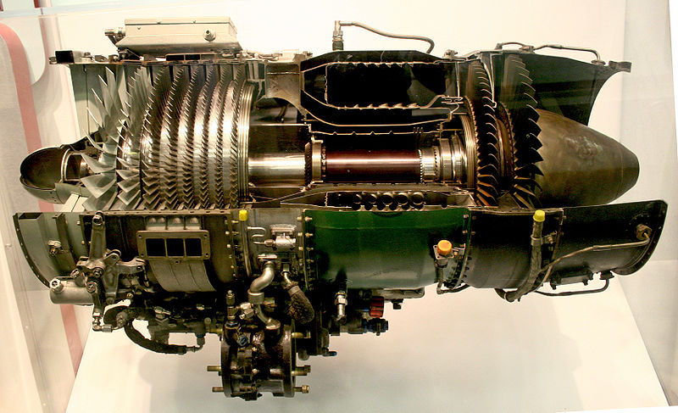
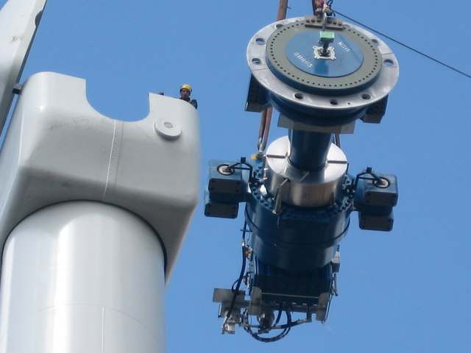
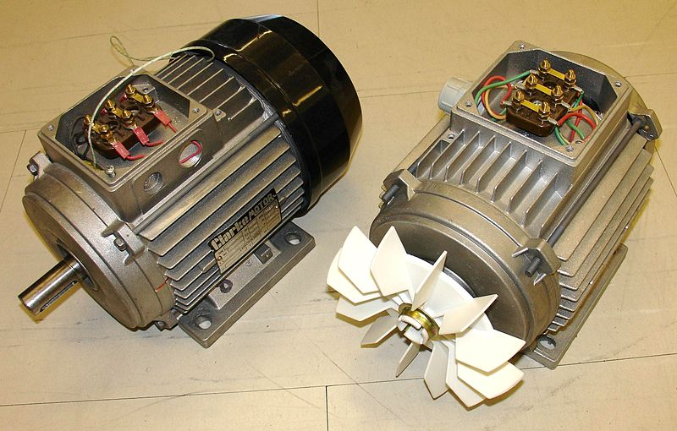
Background
Rolling element bearings are used in rotating machines in different industry sections.
Bearings
Bearing
http://en.wikipedia.org/wiki/File:J85_ge_17a_turbojet_engine.jpg
Computer cooling fan
Gas turbine engine
Bearings inside
http://en.wikipedia.org/wiki/File:Scout_moor_gearbox,_rotor_shaft_and_brake_assembly.jpg
http://en.wikipedia.org/wiki/File:Silniki_by_Zureks.jpg
Bearing
Wind turbine gearbox
Induction motor

Slide 3
Health Monitoring of Bearing
Bearing failure is a concern is a concern for many industrial sections
Bearing fault is a main source of system failure, e.g.: Gearbox bearing failure is the top contributor of the wind turbine’s downtime [1, 2].
The failure of bearing can result in critical lost, e.g.: Polish Airlines Flight 5055 Il-62M crashed because of bearing failure [3].
http://en.wikipedia.org/wiki/File:DanishWindTurbines.jpg
http://en.wikipedia.org/wiki/File:LOT_Ilyushin_Il-62M_Rees.jpg
Offshore wind turbines
LOT Polish Airlines Il-62M
Vibration signal is widely used in the health monitoring of bearing
It is sensitive to the bearing fault. The fault can be detected at an early stage.
It can be monitored in-situ.
It is inexpensive to acquire.

Slide 4
Project Objectives
How to detect the bearing fault? Test if the vibration signal x(t) contains the faulty bearing signal s(t)
Faulty bearing: x(t) = s(t) + ν(t)
Normal bearing: x(t) = ν(t), where v(t) is the noise, which is unknown
How to test the existence of faulty bearing signal s(t)? Check if unique frequency component of s(t) can be extracted.
Faulty bearing signal is a modulated signal : s(t) = d(t)c(t)
d(t) is the modulating signal. Its frequency component is the fault signature. The frequency is provided by the bearing manufacturer.
c(t) is the carrier signal, which is unknown.
Objective of the project: given vibration signal x(t), test if the frequency component of d(t) can be extracted.

Slide 5
Approach
Use FIR filter-bank to decompose the test signal into sub-signals.
Use spectral kurtosis (SK) to locate the sub-signal which contains faulty bearing signal s(t). SK is the kurtosis of the discrete Fourier transform of the vibration signal. The sub-signal containing faulty bearing signal has higher SK [4].
Apply simulated annealing (SA) to optimize the frequency band of the located sub-signal.
The optimum frequency band is determined by the optimum filter.
The filter is optimized by solving the following problem:
f_{c} is the frequency band’s central frequency; Δf is the width of the band; M is the order of FIR filter; f_{Faul} is the fault feature frequency; f_{s} is the sampling rate.
Perform envelope analysis (EA) to the sub-signal which has the optimum frequency band to extract the fault feature frequency (modulating frequency)

Slide 6
Flow Chart of the Algorithm
SA
Maximize SK by f_{c}, Δf, M
Maximized SK
SK_{o}
x(n)
FIR filter
h_{i} (f_{ci}, Δf_{i}, M_{i})
y_{i}(n)
SK
SK_{i}
x(n)
Optimized FIR filter
h(f_{co}, Δf_{o}, M_{o})
y_{o}(n)
a(n)
A(f)
EA
FFT
Magnitude
|A(f)|
x(n) is the sampled vibration signal;
y_{i}(n) is filtered output of the ith FIR filter h_{i};
SK_{i} is the SK of the y_{i}(n);
y_{o}(n) is the output of the optimized FIR filter;
a(n) is the envelope of y_{o}(n) ;
A(f) is the FFT of a(n)
No
f=f_{Fault}?
The bearing is normal
Yes
The bearing is faulty

Slide 7
Filter-bank

Slide 8
Band-Pass Filter the Vibration Signal
FIR filter is defined as
M is the order of the filter. b_{i} is the coefficient of the filter.
Matlab’s built-in function “fir1” is used. It uses the following method
h_{d}(n) is the impulse response of the filter
w(n) is the Hamming window
Therefore, the filtered signal y(n) is a function of f_{c}, Δf, M.

Slide 9
Initial Input for Simulated Annealing
Initial input w(f_{c1}, Δf₁, M₁) is obtained by calculating SK for a binary tree of FIR filter-bank.
Output of the jth filter at level k is
Structure of the filter-bank
Frequency bands are ranked according to their SK value from large to small. Top h frequency bands are selected as the initial input.

Slide 10
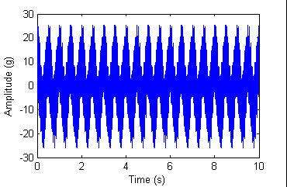
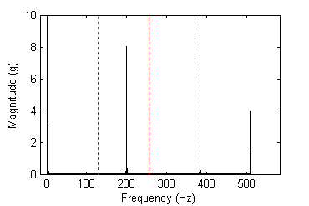
Validation of the Filter-bank
The test signal has four frequency components.
One component locates at the edge of two filters in frequency domain.
Two components locates near the edge of the filter.

Slide 11
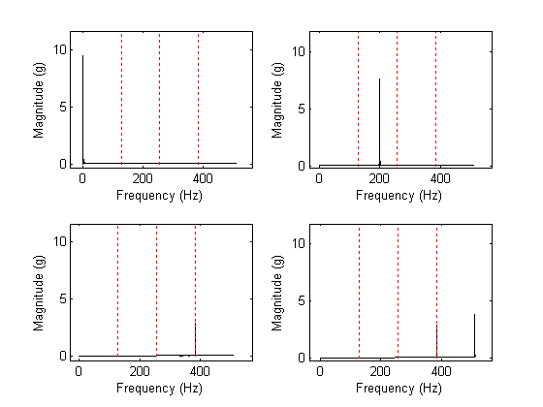
Validation of the Filter-bank
Two level filter-bank is used, which has 4 filters. For sampling rate = 1024Hz, the filters are [0, 128]Hz, [128, 256]Hz, [256,384]Hz, [384, 512]Hz
Frequency components are observed in the right frequency bands. But the magnitude is reduced.
Magnitude=9.5
Magnitude=7.6
Magnitude=2.85
Magnitude=2.85, 3.8

Slide 12
Spectral Kurtosis

Slide 13
Spectral Kurtosis
Definition of spectral kurtosis
where Y(m) is the DFT of the signal y(n); κ_{r} is the rth order cumulant. Both y(n) and Y(m) are N points sequences. SK is a real number.
Estimation of spectral kurtosis
DFT of a stationary signal is a circular complex random variable, and E[Y(m)²]=0, E[Y* (m)²]=0. [5]

Slide 14
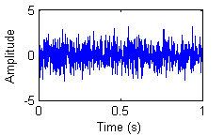
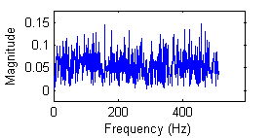
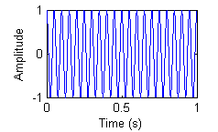
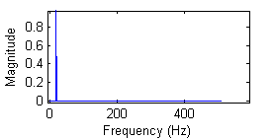
Result of SK
The SK have small value for white noise and high values for periodic signal.
White noise, SK = -0.0406
Pure periodic signal , SK = 510

Slide 15
Simulated Annealing

Slide 16
Simulated Annealing
Simulated annealing [6] is a metaheuristic global optimization tool.
In each round of searching, there is a chance that worse result is accepted. This chance drops when the iterations increase. By doing so, the searching can avoid being trapped in a local extremum.
Initialize the temperature T
Use the initial input vector W
Compute function value SK(W)
Generate a random step S
Keep x unchanged, reduce T
Compute function value SK(W+S)
No
SK(W+S) < SK(W)
No
exp[(SK(W) - SK(W+S) )/T] > rand ?
Yes
Replace W with W+S, reduce T
Yes
Termination criteria reached?
Yes
End a round of searching

Slide 17
Validation of SA: 1-D Function
One dimensional function optimization
The function has a global minimum and many local minimums.
The function is used to check the fundamental of the algorithm.
The global minimum is y=-100 when x= π

Slide 18
Setting of the SA
Initialize the temperature T
T = 1000
Use the initial input vector W
W: A random number in [-10,10]
Compute function value SK(W)
S: A random number in [-10,10]
Generate a random step S
Keep x unchanged, reduce T
T = 0.99T
Compute function value SK(W+S)
No
SK(W+S) < SK(W)
No
exp[(SK(W) - SK(W+S) )/T] > rand ?
Yes
Replace W with W+S, reduce T
Yes
T = 0.99T
Termination criteria reached?
1,000 iterations
Yes
End a round of searching

Slide 19
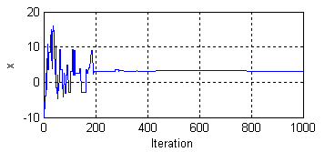
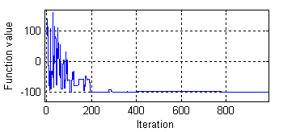
Validation of SA: Result
Result
SA ends at 1,000 iterations. The optimum is found at 943th iteration.
The minimum found is -99.9996,
Optimum variable x= 3.1389

Slide 20
Validation of SA: 3-D Function
Three dimensional function optimization
The function has three variables, it is used to validate the algorithm…
The global minimum is y=-150 when x₁= π, x₂=0, and x₃=- π.

Slide 21
Setting of the SA
Initialize the temperature T
T = 1000
Use the initial input vector W
W: A vector, each element is a number in [-10,10]
Compute function value SK(W)
S: A vector, each element is a number in [-10,10]
Generate a random step S
Keep x unchanged, reduce T
T = 0.99T
Compute function value SK(W+S)
No
SK(W+S) < SK(W)
No
exp[(SK(W) - SK(W+S) )/T] > rand ?
Yes
Replace W with W+S, reduce T
Yes
T = 0.99T
Termination criteria reached?
100,000 iterations
Yes
End a round of searching

Slide 22
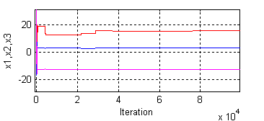
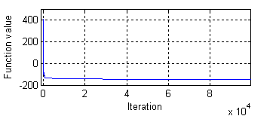
Validation of SA: Setting and Result
Result
SA ends at 100,000 iterations. The optimum is found at 76,455th iteration.
The minimum found is -149.5179
Optimum variable x= [3.1437 15.6941 -12.5659]

Slide 23
Envelope Analysis

Slide 24
Envelope Analysis
The enveloped signal is obtained from the magnitude of the analytic signal.
The analytic signal is constructed via Hilbert transform.
Hilbert transform shifts the signal by π/2 via the following formula
The analytic signal is constructed
Magnitude of the analytic signal forms the enveloped signal.
Enveloped signal
Original signal
Hilbert transform of the original signal

Slide 25
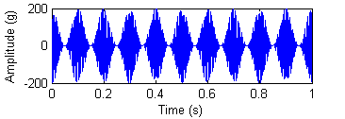
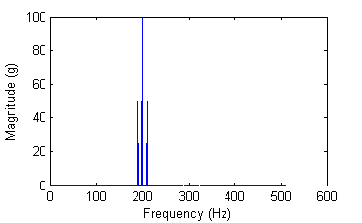
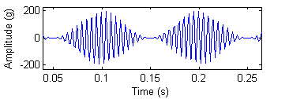
Validation of Envelope Analysis: Test Signal
A modulated signal y is used to validate the algorithm.
200Hz
190Hz
210Hz

Slide 26
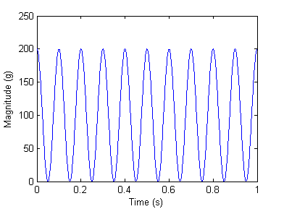
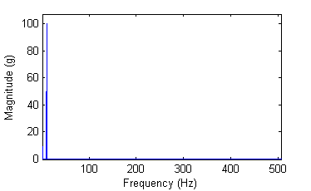
Validation of Envelope Analysis
After envelope analysis, modulating signal is obtained with a different magnitude.
After FFT, the modulating frequency component is obtained.
10Hz

Slide 27
Progress
October
Literature review; exact validation methods; code writing
November
Middle: code writing
End: Validation for envelope analysis and spectral kurtosis
December
Semester project report and presentation
February
Complete validation
March
Adapt the code for parallel computing
April
Validate the parallel version
May
Final report and presentation

Slide 28
Remaining Work at this Stage
Complete the validation of spectral kurtosis.
Put the sub-programs together to a single program.
Validate the whole program.

Slide 29
References
[1] Wind Stats Newsletter, 2003–2009, vol. 16, no. 1 to vol. 22, no. 4, Haymarket Business Media, London, UK
[2] H. Link; W. LaCava, J. van Dam, B. McNiff, S. Sheng, R. Wallen, M. McDade, S. Lambert, S. Butterfield, and F. Oyague,“Gearbox Reliability Collaborative Project Report: Findings from Phase 1 and Phase 2 Testing", NREL Report No. TP-5000-51885, 2011
[3] Plane crash information
http://www.planecrashinfo.com/1987/1987-26.htm
[4] J. Antoni, “The spectral kurtosis: a useful tool for characterising non-stationary signals”, Mechanical Systems and Signal Processing, 20, pp.282-307, 2006
[5] P. O. Amblard, M. Gaeta, J. L. Lacoume, “Statistics for complex variables and signals - Part I: Variables”, Signal Processing 53, pp. 1-13, 1996
[6] S. Kirkpatrick, C. D. Gelatt, and M. P. Vecchi, "Optimization by Simulated Annealing". Science 220 (4598), pp. 671–680, 1983

